Slide 1
Delayed Free
Pengfei Sun

Slide 2
Use-After-Free Exploit
Step 1: Allocate
a = new A();
Heap block of object A
Step 2: Free
Object A free, there is still reference to A
Heap block of object A
Freed
Step 3: Control
Allocate proper object to control memory of A
Feel the heap block with attacker controlled data
Step 4: Use
Use the reference to dereference object A
Accessed as object A with attacker controlled data

Slide 3
Related work
Free
Alloc (control freed memory)
Reuse
FreeSentry (NDSS’15)
DangNull(NDSS’15)
DangSan(EuroSys’17)
Deferred Free (IE’14)
MemGC(IE’15)
DieHard (PLDI’06)
Dieharder(CCS’10)
Cling(Usenix’10)
AddressSantizier( ATC’12)
Shadow (DSN’06)
Oscar (Usenix’17)
CETS (ISMM’10)

Slide 4
Focus on Free (idea)
Free
Alloc (control freed memory)
Reuse

Slide 5
Defense: Delayed Free
Examine total size of blocks placed on free wait list since last scanning
Free Request
>= n?
Yes
Scanning (Policy)
No
Add block X to waiting list

Slide 6
Scanning Policy (Previous IE work)
IE Mitigation:
Memory Protector (deferred free) [IE10 and below]: Consider stack and register based UAFs. Once reached threshold, it will scan the stack and register to figure out whether there are any reference.
When delete is called on an object instance, its contents is zero wrote, and it is placed in a queue. Once the queue has reached a threshold size, we then begin the process of seeing if it is safe to free each object instance in the queue.
To test to see if it is safe to free an object instance, we scan both the registers and all pointer aligned stack entries to see if there exists a pointer to the object. If no pointer is found then the object is freed, otherwise the object is kept in the queue.
MemGC (new version memory protector) [Edge & IE11]: Consider stack, heap and register. Once reached threshold, it will scan the heap, stack and register to check reference by garbage collection method.
If any references are found, we then just need to check to see what objects they are associated with. If the object containing the reference is also tracked by MemGC (i.e. allocated via HeapAlloc() or HeapAllocClear()), then MemGC will not free the object we are interested in
Uses a separate managed heap (MemGC heap) and a concurrent mark-and-sweep garbage collector

Slide 7
IE Mitigation Problem
Value-based analysis
Mistake integer or floating point to pointer (memory address)/pointer cast to integer
bypass ASLR: Abusing Silent Mitigations, where’s my heap?
type-unsafe memory reuse
When pointer protection enable, miss pointer
pointer protection
Performance
scanning the heap/stack/register (conservative garbage collection)
Benign dangling pointer

Slide 8
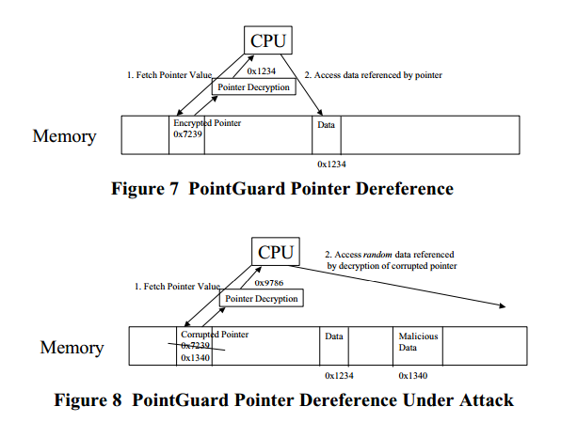
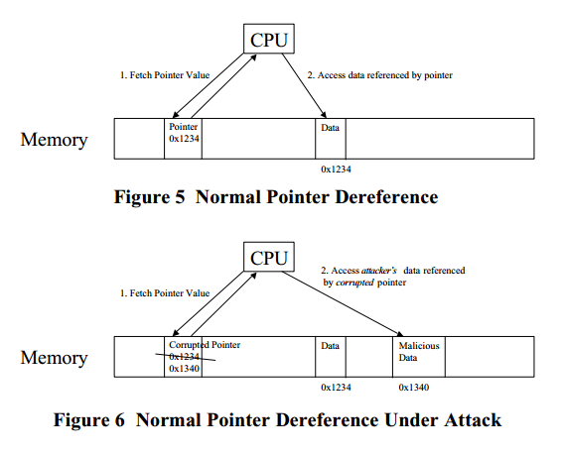
Pointer Protection

Slide 9
Scanning Policy (idea)
Pointer alias analysis
Type-based analysis
keep live pointer set
remove type confusion
save the performance overhead
Accurate garbage collection
Accurate garbage collection requires the ability to identify all pointers in the program at run-time (which requires that the source-language be type-safe in most cases). Identifying pointers at run-time requires compiler support to locate all places that hold live pointer variables at run-time, including the processor stack and registers
They don't have to scan values that don't contain pointers, and because they're never confused about the difference between integers and pointers, they can free objects even if an integer happens to contain a value that's the same as the object's address.
Realloc problem. The realloc function returns a new pointer and invalidates the old one. If the object is aliased, you have a problem, because now you've made the other pointer into a dangling reference.

Slide 10
Pointer Alias Analysis
Firefox LLVM alias analysis:
===== Alias Analysis Evaluator Report =====
873632 Total Alias Queries Performed
72016 no alias responses (8.2%)
772906 may alias responses (88.4%)
23392 partial alias responses (2.6%)
5318 must alias responses (0.6%)
Alias Analysis Evaluator Pointer Alias Summary: 8%/88%/2%/0%
3670340 Total ModRef Queries Performed
3562360 no mod/ref responses (97.0%)
4175 mod responses (0.1%)
8592 ref responses (0.2%)
95213 mod & ref responses (2.5%)
Alias Analysis Evaluator Mod/Ref Summary: 97%/0%/0%/2%

Slide 11
Idea (old)
Binary
Binary analysis to extract type or other information
intraprocedural analysis
How to use the type information for each execution point
Source code
gdb similar
Lee instrument store pointer

Slide 12
Idea (basic)
Type information (pointer or non-pointer)
Source code (based on previous work pointer tracking)
Dangsan
FreeSentry
Binary
Static analysis
Pointer in runtime
shadow memory (instrumentation)
map the whole memory space of process
memory address + first one bit (1 or 0)
Liveness analysis
LLVM plugin
Data flow analysis

Slide 13
Idea (2)
Liveness and then pointer type
Static analysis
find all liveness information and pointer type
instrumentation
Runtime
keep one liveness set
Think about source code and binary code

Slide 14
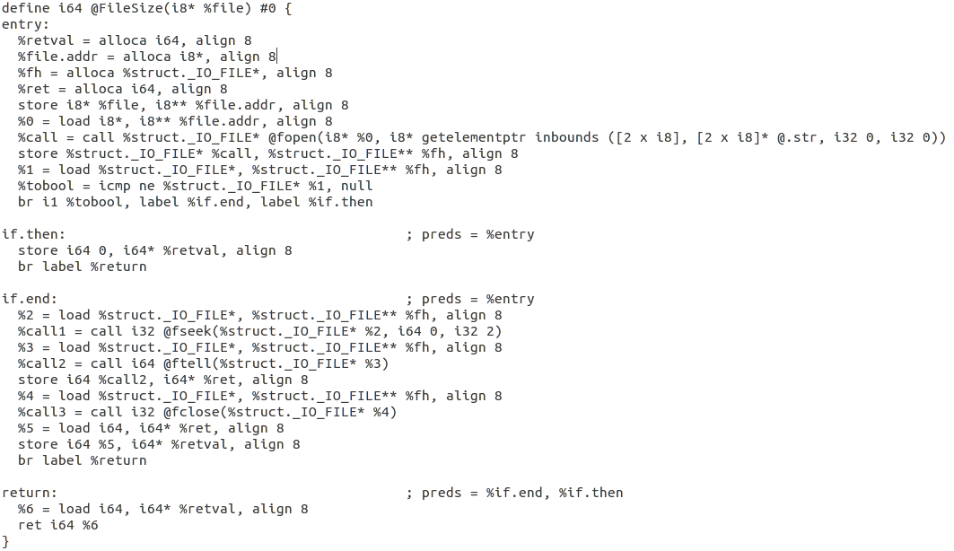
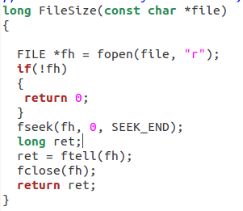
LLVM IR

Slide 15
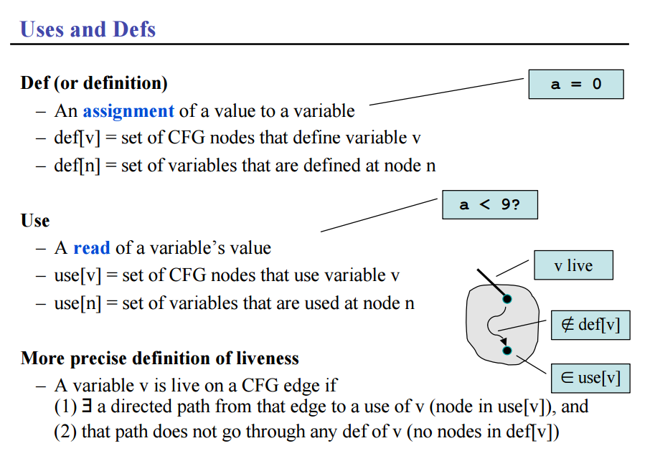
Liveness analysis
Liveness pass
Liveness def
Liveness pointer
Liveness for GC
Notes:
Fast Liveness Checking for SSA-Form Programs: http://www.rw.cdl.uni-saarland.de/~grund/papers/cgo08-liveness.pdf
Computing Liveness Sets for SSA-Form Programs:https://hal.inria.fr/inria-00558509v1/document
http://blog.csdn.net/dashuniuniu/article/details/50723930

Slide 16
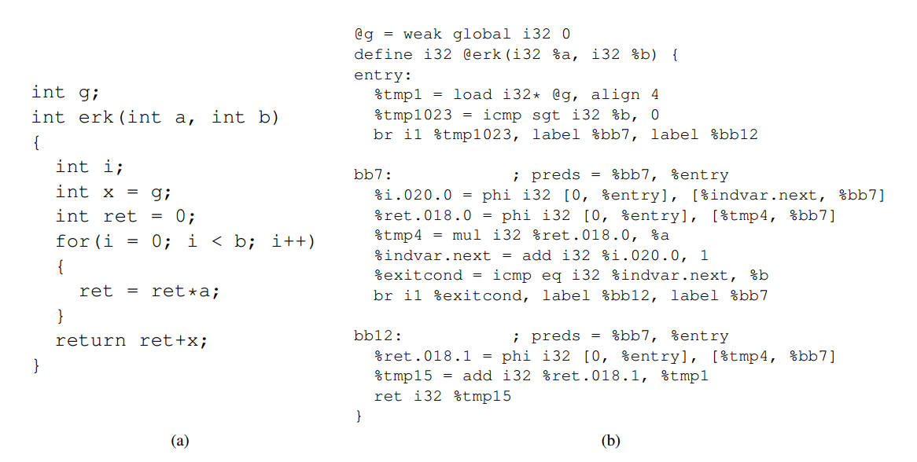
Liveness example

Slide 17
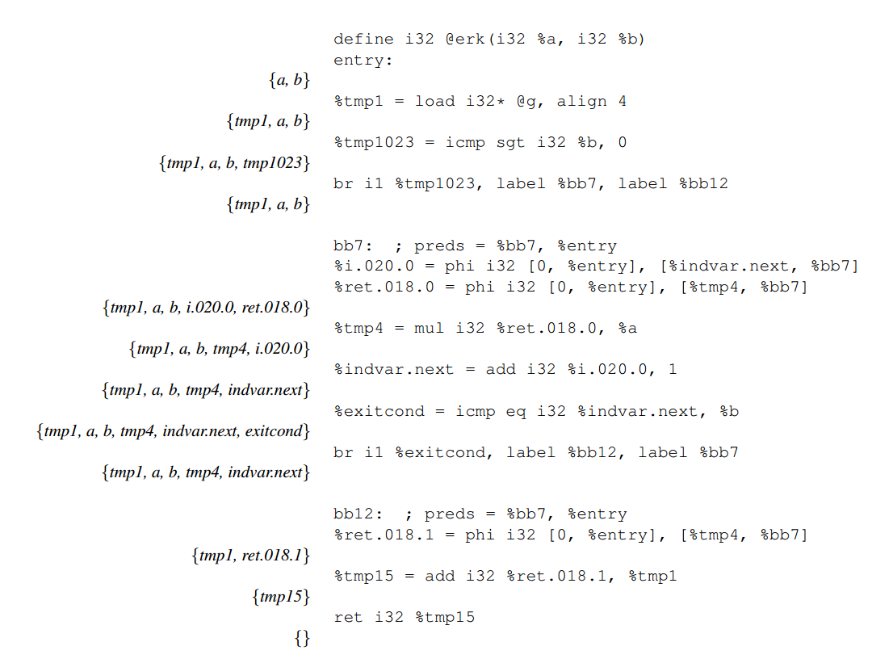
Liveness Example

Slide 18
ToDo question?
Why we cannot find all pointers type in binary code?
How we can use the pointers type information in runtime?
Stack layout analysis
https://www.csee.umbc.edu/~chang/cs313.s02/stack.shtml
Previous work:
Dangsan
FreeSentry
Pointer:
function pointer
saftestack

Slide 19
Binary code (New Idea)
Binary code to IR
liveness analysis
how is used in future
whether dereference
Problem:
linked list, next data structure
Instrument
call
free
for heap content, how to record them?

Slide 20
Defense: Delayed Free
Examine total size of blocks placed on free wait list since last scanning
Free Request
>= n?
Yes
Scanning (Policy)
No
Add block X to waiting list

Slide 21
Scanning policy
Collecting Live pointers (static analysis)
traditional compiler liveness analysis
live pointer expression which from data structure with pointer field
Instrument all live pointers and live pointer expression (dynamic analysis)
Call
Return
Free

Slide 22
Static analysis to add instrumented code
free(d);
collect_live_pointer(&a);
collect_live_pointer(&b);
collect_live_pointer(&(*(*(*c+ 0x20)+ 0x8)));

Slide 23
Source Code
free(temp->next); // Free memory
printf("\nafter free: %p\n", temp->next);

Slide 24
LLVM liveness analysis
; %temp,
%54 = load %struct.Node** %temp, align 8
; %temp, %54,
%55 = getelementptr inbounds %struct.Node* %54, i32 0, i32 1
; %temp, %55,
%56 = load %struct.Node** %55, align 8
; %temp, %56,
%57 = bitcast %struct.Node* %56 to i8*
; %temp, %57,
call void @free(i8* %57) #3
; %temp,
%58 = load %struct.Node** %temp, align 8
; %58,
%59 = getelementptr inbounds %struct.Node* %58, i32 0, i32 1
; %59,
%60 = load %struct.Node** %59, align 8
; %60,
%61 = call i32 (i8*, ...)* @printf(i8* getelementptr inbounds ([17 x i8]* @.str1, i32 0, i32 0), %struct.Node* %60)

Slide 25
Assembly code
.text:000000000040074B mov rax, [rbp+temp]
.text:000000000040074F mov rax, [rax+8]
.text:0000000000400753 mov rdi, rax ; ptr
.text:0000000000400756 call _free
.text:000000000040075B mov rax, [rbp+temp]
.text:000000000040075F mov rax, [rax+8]
.text:0000000000400763 mov rsi, rax
.text:0000000000400766 mov edi, offset aAfterFreeP ; "\nafter free: %p\n"
.text:000000000040076B mov eax, 0
.text:0000000000400770 call _printf

Slide 26
Live pointer expression
Live pointer expression
data structure with pointer field
pointer encryption
ptr-exp derivation aims to produce an address-independent expression of each pointer in future executed control path.
How to get the expression
symbolic expression

Slide 27
Extract Data structure by LLVM pass
Static data structure
Dynamic data structure
linked list
how to recognize linked list
field has the same data structure type with base data structure

Slide 28
Another idea
Static taint analysis for each malloc
https://machiry.github.io/blog/2017/05/31/static-taint-tracking
clang taintchecker: https://github.com/franchiotta/taintchecker/tree/master/examples
clang static analysis for finding heartbleed: https://blog.trailofbits.com/2014/04/27/using-static-analysis-and-clang-to-find-heartbleed/

Slide 29
Build Scan Policy
Liveness analysis
regular compiler liveness analysis result
If there are any data structure type, we need to compare with related malloc set
Build unique set for each heap memory allocation (e.g. malloc)
static taint analysis for each malloc’s return value
set life cycle for each variable in each unique set
function return, different stack frame
maintain one list [(memory object, memory location),]
figure out the efficient data structure for each malloc set
easy to update
maintain the relationship for each malloc set
IR special feature (all access is based on the base pointer)
Store A[(memory location, ptr, base pointer), (memory location, ptr, base pointer)]
Static analysis and Dynamic analysis

Slide 30
Basic story
struct ptr{
int integer;
struct ptr * p;
}
Liveness Analysis
Live Set {a (struct ptr *), b (int *), c (char), d (char*), e (long)}
Heap tracker generates unique set for each memory object:
maintain relationship
update(add or remove)
pointer expression:
static data structure, and dynamic data structure (linked list, tree, graph..)

Slide 31
Data structure
Live Set [(Mem addr, ptr value, type), (Mem addr, ptr value, type) ...]
Memory object reference list:
[(Mem addr, ptr value, base ptr), (Mem addr, ptr value, base ptr) ...]
Update list: [(Mem obj, Mem addr), (Mem obj, Mem addr) ...]

Slide 32
Problem
Generate reference list for each memory object
Update reference list
Stack
Heap

Slide 33
Previous Work Problem
They need source code support.
They cannot handle library UAF problem expect they use the recompiled library based on their solution.
They cannot detect pointer cast to integer problem and pointer protection
They don't track the pointer which in the register, since they only record the memory location which store the memory objection pointer.
Since they null the dangling pointer, so the pointer arithmetic which uses dangling pointer will be failed.
Multi-thread problem. For example, one thread load the pointer to register, and another thread free the memory object. So the pointer which in register will not be NULL.
Higher run-time overhead
Bypass secure memory allocators

Slide 34
Implementation
Binary or source code
Binary to IR
How to get type information about pointer
compiler / data type recovery ()
How to use the type information to live memory
How to get the live pointer set for each execution point
How to deal with pointer encryption problem
How to compare with other defense solution by CPU bench
How to test the IE performance
How to compare with IE security and performance

Slide 35
Related Work
Dynamic analysis (most papers are defense papers)
Pointer invalidation
Pointer dereference checking
Secure memory allocators
Taint tracking
Static analysis (exploring)
Static analysis and Dynamic analysis (exploring)
Source code or Binary only

Slide 36
Pointer invalidation
Keep track of pointers to each object and invalidate them once an object is freed.
FreeSentry: Protecting Against Use-After-Free Vulnerabilities Due to Dangling Pointers (NDSS 15)
Can track all pointers, but cannot support multithreaded programs
source code requirement （compile time)
Source code transformation and insert runtime code to track pointers and invalidate when free
25% (CPU Bench, Apache and OpenssH)
Preventing Use-after-free with Dangling Pointers Nullification (NDSS 15)
Automatically trace the point-to relations between pointers and memory objects
Only in the heap, stack-located pointers are unlikely to be exploitable (short lifetime)
source code requirement, overhead 80% (SPEC CPU), range information, lock
DangSan: Scalable Use-after-free Detection (EuroSys 17)
Track all pointers, support multithreaded programs, and focus on concurrency efficiently.
source code requirement
22% (CPU Bench)

Slide 37
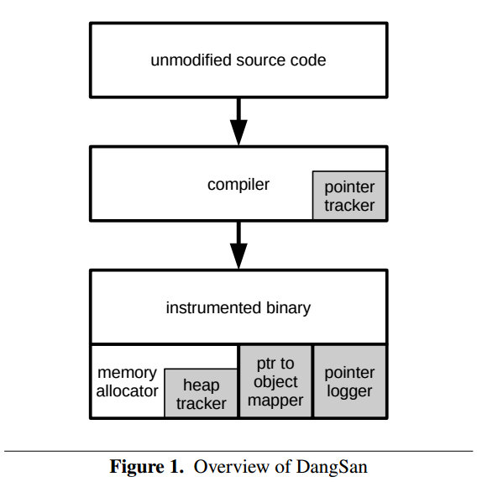
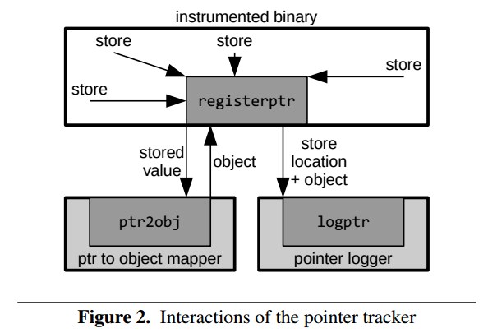
DangSan: Scalable Use-after-free Detection (EuroSys 17)

Slide 38
DangSan: Scalable Use-after-free Detection (EuroSys 17)
How to check validity of (memory location, ptr to memory object)?
the value in memory location can be rewriting.

Slide 39
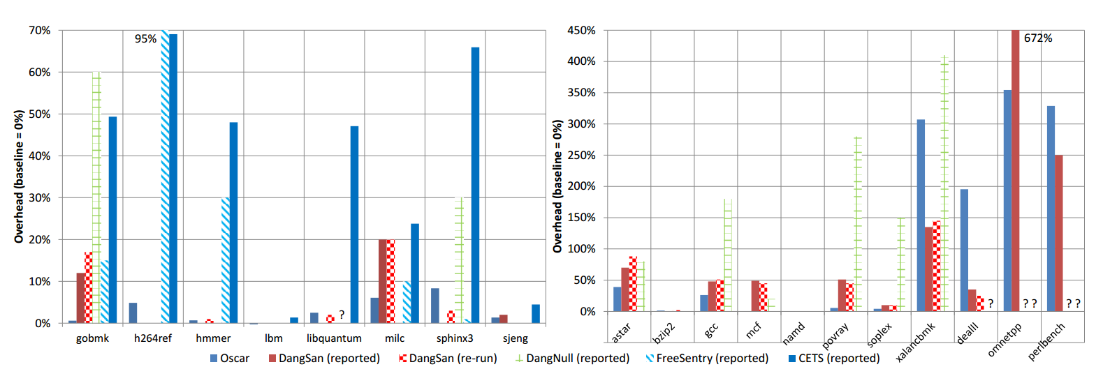
Performance

Slide 40
Problem
DangNull/FreeSentry/Dangsan do not work correctly with encrypted pointers (e.g., PointGuard [20]) or with typecasting from non-pointer types. Additionally, DangNull does not allow pointer arithmetic on freed pointers. For example, suppose we allocate a string p on the heap, search for a character, then free the string:
char* p = strdup("message"); // Memory from malloc
char* q = strchr(p, ’a’); // Find the first ’a’
free(p);
Computing the index of “a” (q - p == 3) fails with DangNull, since p and q were nullified. It does work with FreeSentry/Dangsan, since FreeSentry/Dangsan only changes the top 2 bits.

Slide 41
Problem
Dangsan/Freesentry/DangNull:
Compare-and-exchange means that they firstly verify the pointer and then invalidate it
Pointer location hold one integer value, which value is in the same range of memory object, so the integer will invalidate again
type-unsafe memory reuse (char type reuse pointer)
type-unsafe way copy
pointer cast to integer
memcpy() pointer
register value and spill register value to stack
data race problem when freeing
Thread one and thread two

Slide 42
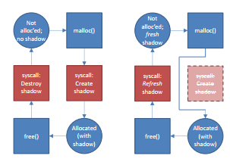
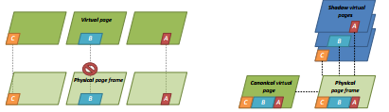
Page Permission
Change the free page permission to avoid dangling pointer
Efficiently Detecting All Dangling Pointer Uses in Production Servers (DSN 06)
source code, create shadow page which occupy the whole page
change the page permission of shadow page
Oscar: A Practical Page-Permissions-Based Scheme for Thwarting Dangling Pointers (Usenix 17)
improve the performance compare the DSN’06

Slide 43
Pointer dereference checking
Perform checking when pointers are dereferenced rather than invalidating them when they are deallocated.
CETS: Compiler-enforced temporal safety for C (ISMM 10)
Attach a label to each allocation and perform a check when dereferenced.
each allocation (key + lock location), deallocation ( NULL for lock location)
Cover the case that pointers are temporarily converted into integers.
Higher run-time overhead (48% CPU Bench)
Source code requirement
CETS has false positives when casting from a non-pointer to pointer, as it will initialize the key and lock address to invalid values

Slide 44
Secure memory allocators
Prevent allocated objects from ending up at the same address as previously freed objects.
DieHard: Probabilistic memory safety for unsafe language (PLDI 06)
binary only
DieHarder: Securing the heap (CCS 10)
binary only
Cling: A memory allocator to mitigate dangling pointers (Usenix Sec 10)
Source code
It only allows address space reuse for freed objects among objects of the same type.
No stack
AddressSanitizer: A fast address sanity checker (Usenix ATC 12)
Allow the attacker to force the reuse of a freed memory region
Source code requirement

Slide 45
Previous Work Problem
They need source code support.
They cannot handle library UAF problem expect they use the recompiled library based on their solution.
They cannot detect pointer cast to integer problem and pointer protection
They don't track the pointer which in the register, since they only record the memory location which store the memory objection pointer.
Since they null the dangling pointer, so the pointer arithmetic which uses dangling pointer will be failed.
Multi-thread problem. For example, one thread load the pointer to register, and another thread free the memory object. So the pointer which in register will not be NULL.
Higher run-time overhead
Bypass secure memory allocators

Slide 46
Taint Tracking
Track the pointer value from its allocation site onward not depending on the variable type.
Undangle: Early Detection of Dangling Pointers in Use-After-Free and Double-Free Vulnerabilities (ISSTA 12)
It can report all the dangling pointers that point to a particular memory location at a given set in time and allows a user to specify a window when to report these findings
Avoid the loss of metadata when pointers are copied in a type-unsafe way
Binary code no source code
Combine Undangle with fuzzing tool
find two dangling pointer bugs in windows libraries

Slide 47
Static Analysis
Staticly detecting use after free on binary code(JICV 14)
binary only
potential UAF patterns: allocation, free, used (dangling pointer)
Abstract memory representation: heap (base, size) and stack (EBP, offset)
Value set analysis
assume no particular loop iteration
small programs
Uncovering Use-After-Free Conditions In Compiled Code (ARES 15)
binary only (potential 127/652 windows binaries)
C++ object with virtual function
data flow analysis: available object definition analysis
compute four sets for each basic block GEN[B], KILL[B], AVAILIN[B], and AVAILOUT[B]
the virtual address of constructor and deleted object
rely on RECALL’s ClassTracker to identify C++ object creation and deletion with high reliability

Slide 48
Combine Static and Dynamic Analysis
Finding the needle in the heap: combining static analysis and dynamic symbolic execution to trigger use-after-free (SSPREW 16)
binary only
GUEB guided dynamic symbolic execution
Poster: UAFChecker: Scalable Static Detection of Use-After-Free Vulnerabilities (CCS 14)
Source code
unroll each loop only once
no depending on executing a loop for several times.
finite-state machine: precise alias analysis (MustAlias and MayAlias)
Inter-procedure analysis: function inlining not good for large program
Symbolic execution: free point to use point
Taint: directly taint untrust pointer

Slide 49
Conservative Mark-Sweep GC
Garbage Collect
Conservative Mark-Sweep GC
does not distinguish between data and pointers in the program at run-time
Preparation Each object has an associated mark bit. Clear all mark bits, indicating that all objects are potentially unreachable.
Mark phase Marks all objects that can be reachable via chains of pointers from variables. Often the collector has no real information about the location of pointer variables in the heap, so it views all static data areas, stacks and registers as potentially containing pointers. Any bit patterns that represent addresses inside heap objects managed by the collector are viewed as pointers. Unless the client program has made heap object layout information available to the collector, any heap objects found to be reachable from variables are again scanned similarly.
Sweep phase Scans the heap for inaccessible, and hence unmarked, objects, and returns them to an appropriate free list for reuse. This is not really a separate phase; even in non incremental mode this is operation is usually performed on demand during an allocation that discovers an empty free list. Thus the sweep phase is very unlikely to touch a page that would not have been touched shortly thereafter anyway.
A garbage collector for C and C++
Accurate garbage collection
have the ability to identify all pointers in the program at run-time
Garbage Collection: Why, When, and How?
Precise Garbage Collection for C
Liveness-Based Garbage Collection

